Slide 1
Huff Research Group Kendra Andersen
Group Meeting 10/9/17

Slide 2
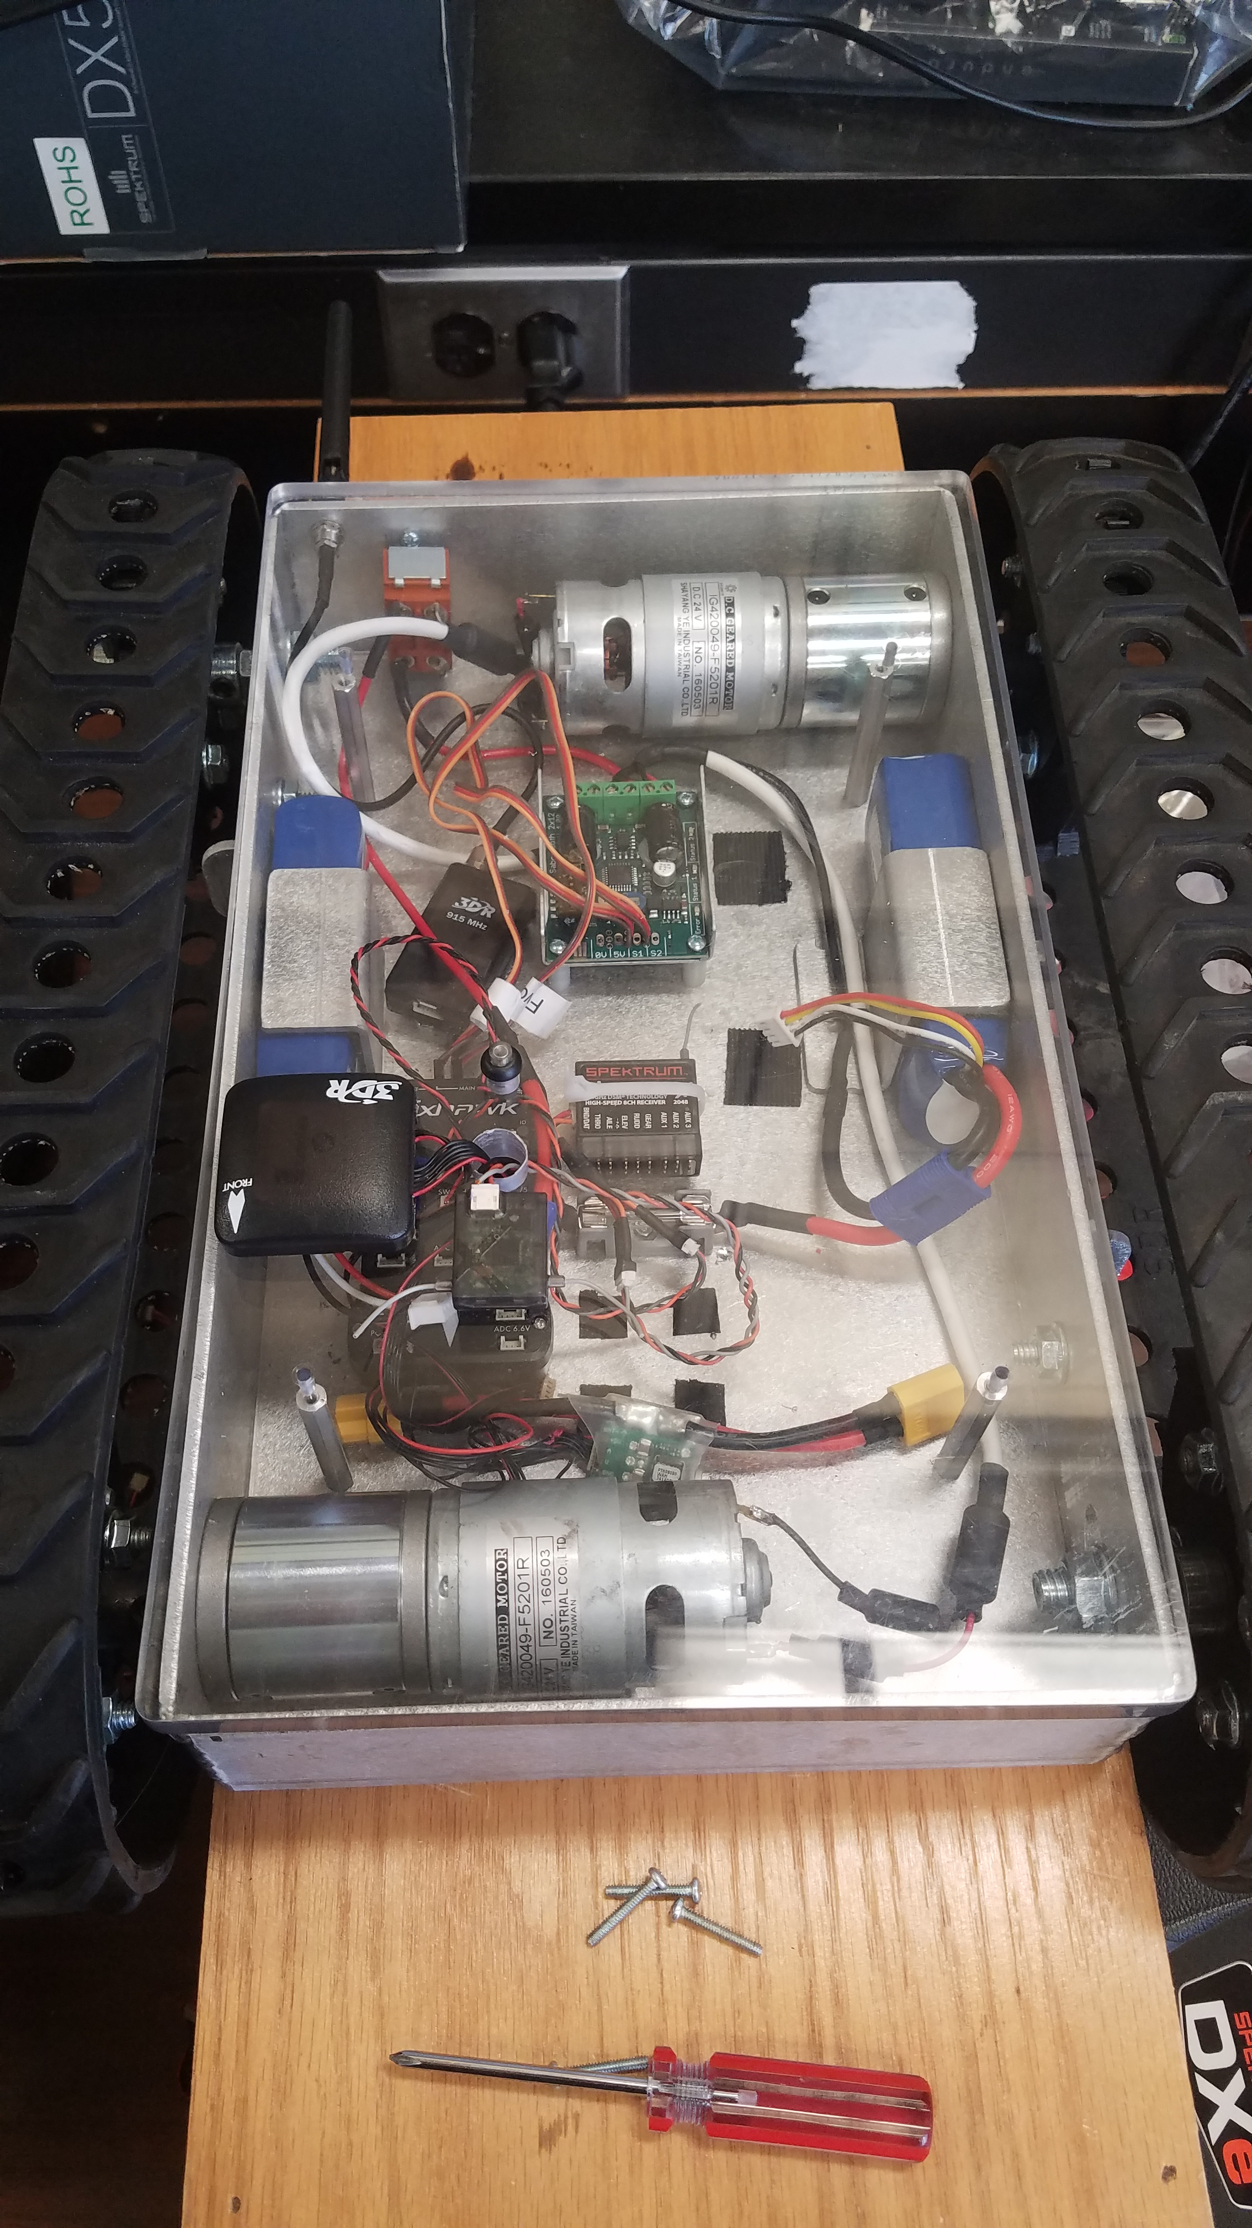
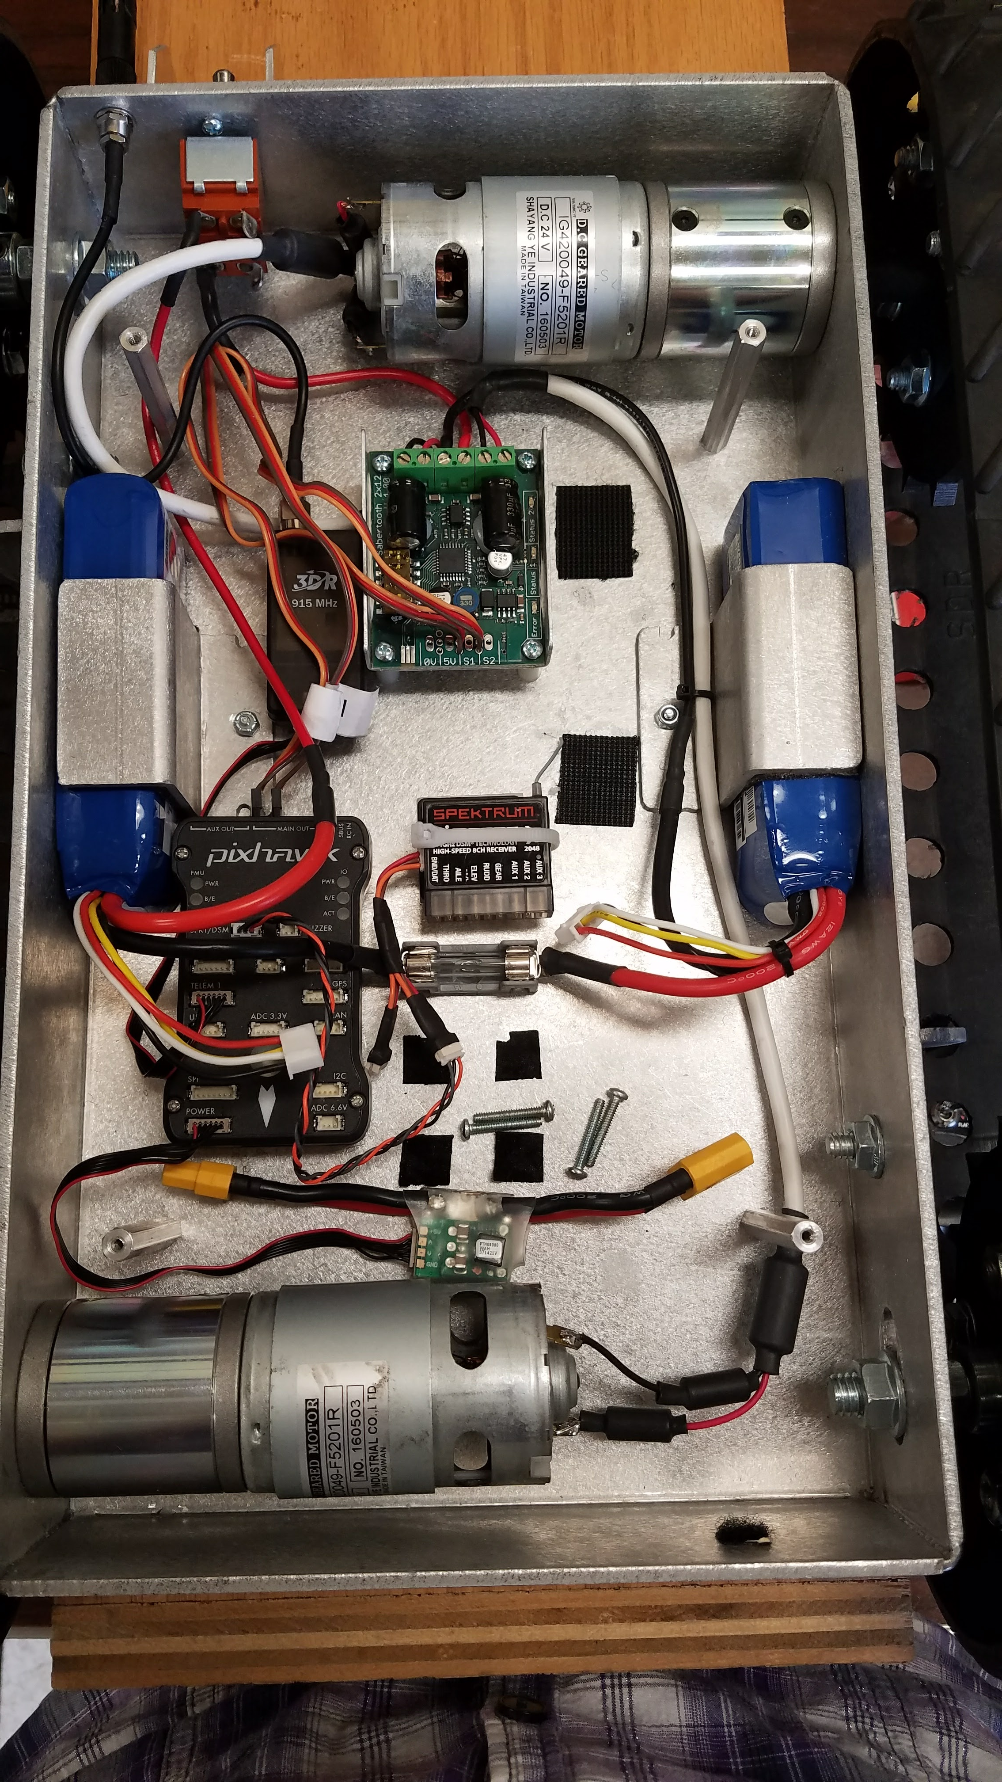

Slide 3
Status
Last Week:
This Week:
Added connectors to smallest rover’s batteries so they could be charged.
Worked on getting software running to measure RSSI and gather GPS data with Ryan.
Managed to get the smallest rover running properly while connected to my laptop.
Gather RSSI/GPS data with Ryan.
Look into Python path planning libraries & start developing preliminary algorithm.
Progress on first URS Installment (due October 30th).
Remember: Mandatory URS Orientation on October 19th (not 12th).

